Slide 1
IBM APPLIED DATA SCIENCE PROFESSIONAL CERTIFICATE
SpaceX Falcon 9 First Stage Landing Prediction
Capstone Project Report — Machine Learning, EDA, SQL, & Interactive Visual Analytics
Author: Niv Vikram Porwal
Date: October 2026 | Platform: Coursera & IBM Skills Network
Project GitHub Repository URL: https://github.com/Nivporwal25/SpaceX-Falcon-9-First-Stage-Landing-Prediction

Slide 2
IBM APPLIED DATA SCIENCE CAPSTONE
Executive Summary: Project Overview & Key Findings
Methodology & Data Science Pipeline
• Data Collection: SpaceX REST API v4 & Web Scraping Wikipedia via BeautifulSoup.
• Data Wrangling: Cleaned 90 Falcon 9 records, imputed nulls with mean payload (6,105 kg), one-hot encoded categorical features (Orbit, LaunchSite, LandingPad, Serial).
• Exploratory Data Analysis: Analyzed flight trends, payload correlations, and success rates by orbit using Pandas, Seaborn, Matplotlib, and SQLite queries.
• Interactive Visual Analytics: Built geospatial Folium maps with distance proximity analysis and Plotly Dash dashboard with reactive callbacks.
• Predictive Modeling: Evaluated Logistic Regression, SVM, Decision Tree, and KNN using 10-fold GridSearchCV cross-validation.
Key Results & Business Implications
• Model Performance: Decision Tree, SVM, and Logistic Regression achieved 83.33% classification accuracy on unseen test data.
• High Precision: Best model achieved 0 False Positives, ensuring 100% precision when predicting a successful first stage recovery.
• Technological Evolution: Landing success rate grew from 0% (2010-2013) to over 85% by 2020 as reusability and Block 5 engines matured.
• Launch Site Performance: KSC LC-39A is the most reliable launch complex with a 76.9% landing success rate.
• Commercial Impact: SpaceX launch price ($62M) vs competitors ($165M+) gives a 62% cost advantage; accurate recovery prediction enables competitors to optimize bidding strategy.
Project GitHub Repository: https://github.com/Nivporwal25/SpaceX-Falcon-9-First-Stage-Landing-Prediction
Slide 2 of 16

Slide 3
IBM APPLIED DATA SCIENCE CAPSTONE
Introduction: Project Background & Problem Statement
Project Background & Aerospace Context
• The space launch industry has historically been dominated by expendable rockets costing over $165 Million per launch.
• SpaceX fundamentally revolutionized commercial spaceflight by proving first-stage booster reusability on Falcon 9.
• By successfully recovering the booster stage via Autonomous Spaceport Drone Ship (ASDS) and Return to Launch Site (RTLS), SpaceX cut launch prices to ~$62 Million.
• First stage booster accounts for approximately 70% of total rocket manufacturing costs.
• Reusability dramatically increases launch cadence and lowers barriers to orbital payloads.
Problem Statement & Analytical Objectives
• Core Question: Can we accurately predict whether a Falcon 9 first stage booster will land successfully based on pre-launch flight parameters?
• Target Classification Variable: Class = 1 (Successful Landing) vs. Class = 0 (Failure / Expended).
• Independent Features: Payload Mass, Target Orbit, Launch Site, Booster Flight Count, Grid Fins, Legs, Block Version, and Landing Pad.
• Commercial Value: If a competitor or satellite operator can predict landing success, they can deduce SpaceX's true cost per flight and submit competitive launch tenders.
• Outcome: Provide data-driven operational insights into factors driving first stage recovery.
Project GitHub Repository: https://github.com/Nivporwal25/SpaceX-Falcon-9-First-Stage-Landing-Prediction
Slide 3 of 16

Slide 4
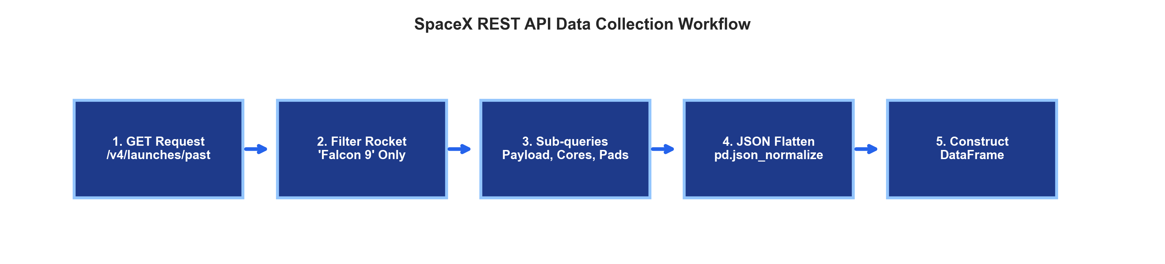
IBM APPLIED DATA SCIENCE CAPSTONE
Data Collection: SpaceX REST API v4
API Endpoints & Extraction Process
• Base API Endpoint: https://api.spacexdata.com/v4/launches/past
• Rocket Details: Queried /v4/rockets to filter records exclusively for 'Falcon 9'.
• Payload Data: Queried /v4/payloads to retrieve payload mass (kg) and target orbit.
• Launchpads: Queried /v4/launchpads to obtain pad names, latitudes, and longitudes.
• Booster Cores: Queried /v4/cores to retrieve booster serial, flights count, grid fins, landing legs, and landing pad IDs.
Data Wrangling of API Responses
• JSON Normalization: Flattened nested JSON dictionaries into tabular format using pd.json_normalize().
• Filtering: Extracted 90 total Falcon 9 flights spanning 2010 to 2020.
• Missing Value Handling: Calculated mean payload mass (6,104.96 kg) to impute missing payload values.
• Feature Assembly: Consolidated 17 primary operational columns into a unified pandas DataFrame.
• API Flowchart above illustrates the end-to-end data pipeline.
Project GitHub Repository: https://github.com/Nivporwal25/SpaceX-Falcon-9-First-Stage-Landing-Prediction
Slide 4 of 16

Slide 5
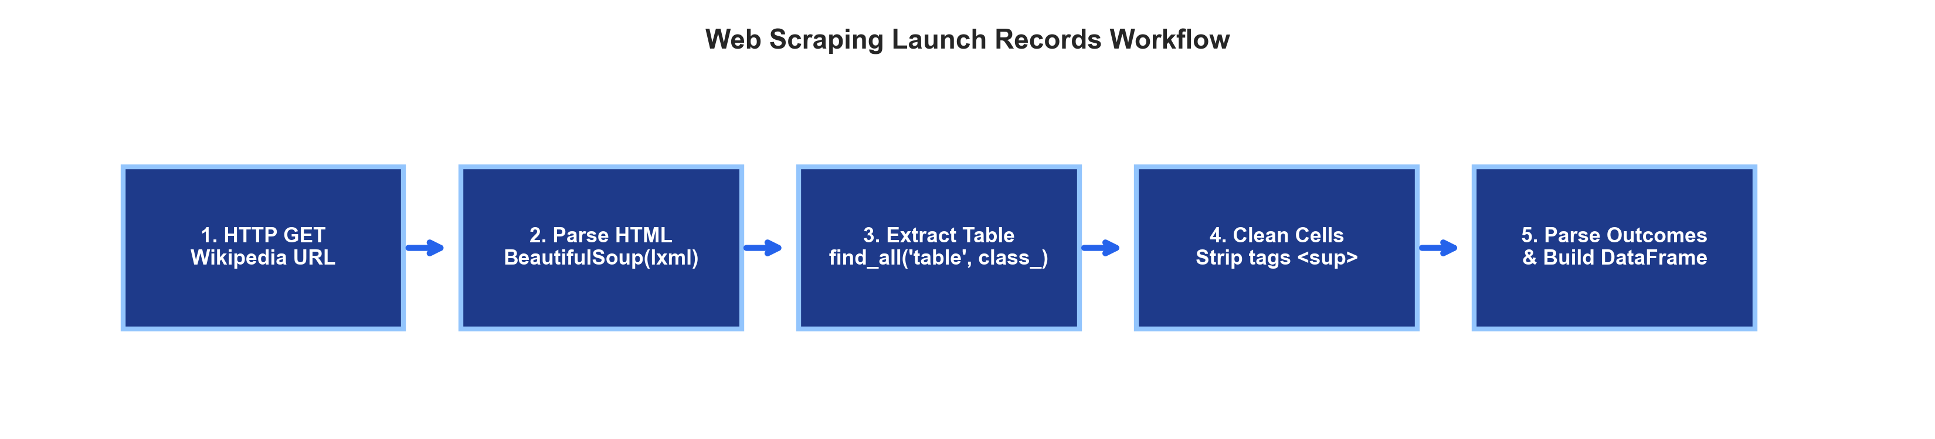
IBM APPLIED DATA SCIENCE CAPSTONE
Data Collection: Web Scraping Falcon 9 Records
Web Scraping Pipeline & Tools
• Target Source: Wikipedia page 'List of Falcon 9 and Falcon Heavy launches'.
• HTTP Requests: Dispatched GET request using Python requests.get() library.
• HTML DOM Parsing: Utilized BeautifulSoup (bs4) with lxml parser.
• Table Extraction: Targeted all <table class='wikitable'> elements containing launch records.
• Cell Extraction: Looped through table rows <tr>, extracting headers <th> and data cells <td>.
Data Cleansing & Validation
• Regex Tag Removal: Stripped footnote references <sup>[n]</sup> and newline characters \n.
• Date & Time Parsing: Extracted standardized UTC launch dates and times.
• Outcome Standardization: Parsed complex textual notes into clear landing outcome categories.
• Cross-Validation: Web-scraped dataset served as validation benchmark against official SpaceX API data.
• Extracted Columns: Flight No., Date, Booster Version, Launch Site, Payload, Orbit, Customer, Outcome.
Project GitHub Repository: https://github.com/Nivporwal25/SpaceX-Falcon-9-First-Stage-Landing-Prediction
Slide 5 of 16

Slide 6
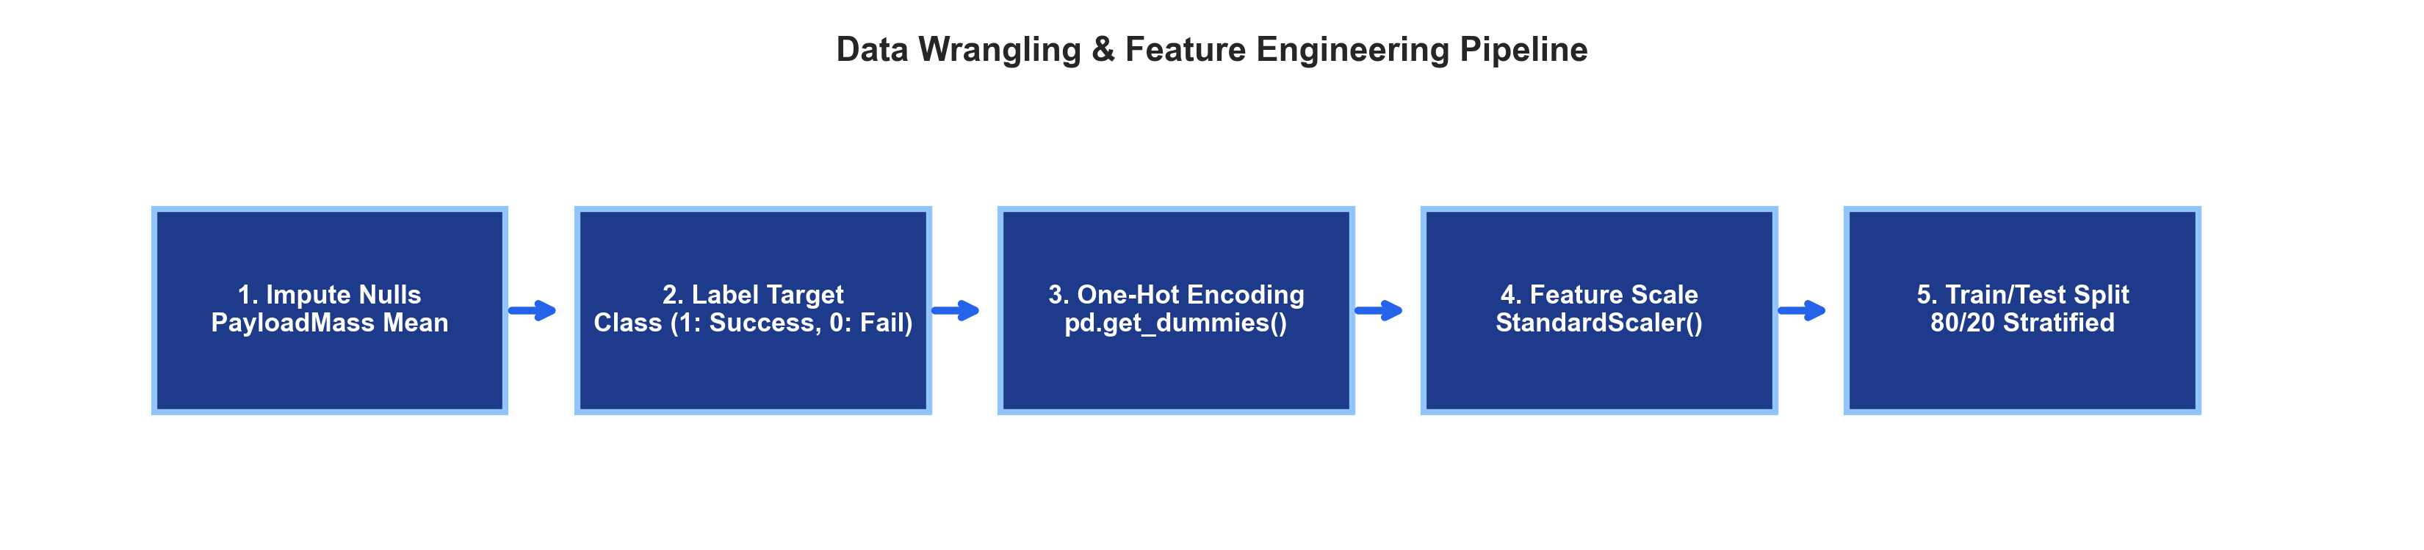
IBM APPLIED DATA SCIENCE CAPSTONE
Data Wrangling & Feature Engineering Methodology
Data Cleaning & Transformation
• Dataset Filtering: Preserved 90 Falcon 9 launch records; removed test/Falcon 1 flights.
• Missing Value Imputation: 5 missing PayloadMass entries imputed with mean (6,104.96 kg).
• Target Variable Creation (Class):
• - Class = 1 (Success): 'True Ocean', 'True RTLS', 'True ASDS'.
• - Class = 0 (Failure): 'False Ocean', 'False RTLS', 'False ASDS', 'None ASDS', 'None None'.
Feature Encoding & Preprocessing
• One-Hot Encoding: Applied pd.get_dummies() to categorical features (Orbit, LaunchSite, LandingPad, Serial).
• Feature Expansion: Transformed 17 initial raw variables into 83 numeric modeling features.
• Feature Scaling: Applied StandardScaler() to standardize feature variance across columns.
• Train/Test Partition: Split into 80% Training (72 records) and 20% Testing (18 records) with stratification.
• Ensured zero data leakage between training and evaluation splits.
Project GitHub Repository: https://github.com/Nivporwal25/SpaceX-Falcon-9-First-Stage-Landing-Prediction
Slide 6 of 16

Slide 7
IBM APPLIED DATA SCIENCE CAPSTONE
Exploratory Data Analysis (EDA): Visualization Methodology
Visualization Suite & Analytical Objectives
• Flight Number vs. Launch Site (Scatter Plot): Analyze launch cadence growth and evaluate whether later flights achieved higher landing success across sites.
• Payload Mass vs. Launch Site (Scatter Plot): Identify payload capacity limits per launch complex and observe success distribution across payload tiers.
• Success Rate by Orbit Type (Bar Chart): Determine which destination orbits (LEO, ISS, GTO, SSO, Polar) offer the most favorable booster recovery conditions.
• Flight Number vs. Orbit Type (Scatter Plot): Map the chronological evolution of orbital mission requirements throughout SpaceX history.
• Payload Mass vs. Orbit Type (Scatter Plot): Examine payload mass distribution across orbits and detect payload recovery threshold constraints.
• Launch Success Yearly Trend (Line Plot): Measure year-over-year recovery reliability improvements from 2010 to 2020.
Visualization Framework & Design Standards
• Plotting Libraries: Matplotlib (v3.5+) and Seaborn (v0.12+) in Python.
• Color Palette: Standardized color scheme across all figures (Green = Success [Class 1], Red = Failure [Class 0]).
• Typography: Clear, bold axis titles, legible data labels, and complete legends for intuitive readability.
• Data Storytelling: Focused on isolating actionable operational insights, booster lifecycle maturation, and payload sweet-spots.
• Artifacts: All plots generated at high resolution (300 DPI) for clarity.
• Full implementation available in the project GitHub repository.
Project GitHub Repository: https://github.com/Nivporwal25/SpaceX-Falcon-9-First-Stage-Landing-Prediction
Slide 7 of 16

Slide 8
IBM APPLIED DATA SCIENCE CAPSTONE
Exploratory Data Analysis (EDA): SQL Query Methodology
Relational Database Setup & Execution
• Database Engine: SQLite (spacex.db) loaded via Python SQLAlchemy & pandas to_sql.
• Query Execution: Executed via Jupyter ipython-sql (%sql magic) and standard sqlite3.
• Core Domains Investigated via SQL Queries:
• 1. Unique Launch Sites identification & naming validation.
• 2. Site-specific launch records filtering (CCAFS pads).
• 3. Total & average payload calculations for specific customers (NASA).
• 4. Payload threshold queries (boosters carrying 4,000 - 6,000 kg).
• 5. Aggregate landing outcomes counts (Drone Ship vs. Ground Pad).
• 6. Date & time analysis (earliest successful landing, yearly counts).
• 7. Ranked landing outcome frequency distributions.
Representative SQL Queries Executed
• Q1 - Launch Sites: SELECT DISTINCT LaunchSite FROM SPACEXTABLE;
• Q2 - Total Payload: SELECT SUM(PayloadMass) FROM SPACEXTABLE WHERE Customer LIKE '%NASA%';
• Q3 - Average Payload: SELECT AVG(PayloadMass) FROM SPACEXTABLE WHERE BoosterVersion LIKE '%v1.1%';
• Q4 - First Ground Landing: SELECT MIN(Date) FROM SPACEXTABLE WHERE LandingOutcome = 'Success (ground pad)';
• Q5 - Max Payload Booster: SELECT BoosterVersion FROM SPACEXTABLE WHERE PayloadMass = (SELECT MAX(PayloadMass) FROM SPACEXTABLE);
• Q6 - Outcome Ranking: SELECT LandingOutcome, COUNT(*) FROM SPACEXTABLE GROUP BY LandingOutcome ORDER BY COUNT(*) DESC;
Project GitHub Repository: https://github.com/Nivporwal25/SpaceX-Falcon-9-First-Stage-Landing-Prediction
Slide 8 of 16

Slide 9
IBM APPLIED DATA SCIENCE CAPSTONE
Interactive Visual Analytics: Folium & Plotly Dash Methodology
Folium Geospatial Mapping Framework
• Geospatial Library: Python Folium built upon Leaflet.js.
• Launch Site Pinpointing: Plotted all 4 SpaceX launch pads using folium.Circle and folium.Marker with coordinate tooltips.
• Marker Clustering: Integrated MarkerCluster plugin to aggregate dense launch clusters without map clutter.
• Color-Coded Status: Green markers denote successful booster landings; Red markers denote failures.
• Coordinate Tracking: Integrated MousePosition plugin for live latitude/longitude readout.
• Proximity Measurement: Used folium.PolyLine to calculate exact straight-line distances to coastlines, highways, railways, and cities.
Plotly Dash Web Application Architecture
• Web Framework: Plotly Dash (Dash Core Components & Dash HTML Components).
• Reactive Interactivity: Configured bidirectional callbacks linking user UI input to real-time graph updates.
• UI Controls:
• - dcc.Dropdown: Switch between 'ALL Sites' and specific launch complexes (CCAFS SLC-40, KSC LC-39A, VAFB SLC-4E).
• - dcc.RangeSlider: Interactive payload filter spanning 0 kg to 10,000 kg.
• Dynamic Graphs:
• - Success Pie Chart: Displays site-specific success vs. failure proportions.
• - Payload vs. Outcome Scatter Plot: Correlates payload mass with recovery success color-coded by booster version.
Project GitHub Repository: https://github.com/Nivporwal25/SpaceX-Falcon-9-First-Stage-Landing-Prediction
Slide 9 of 16

Slide 10
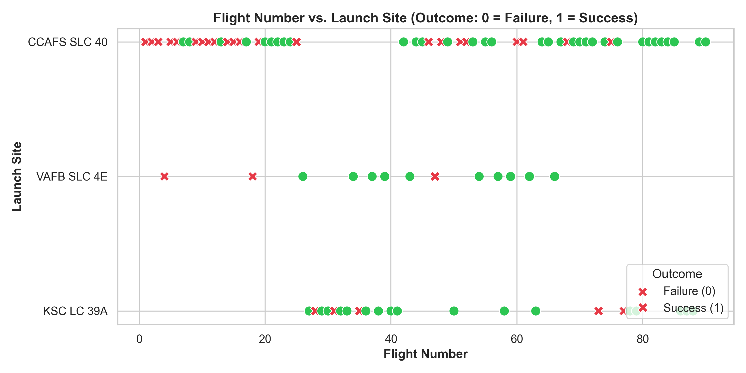
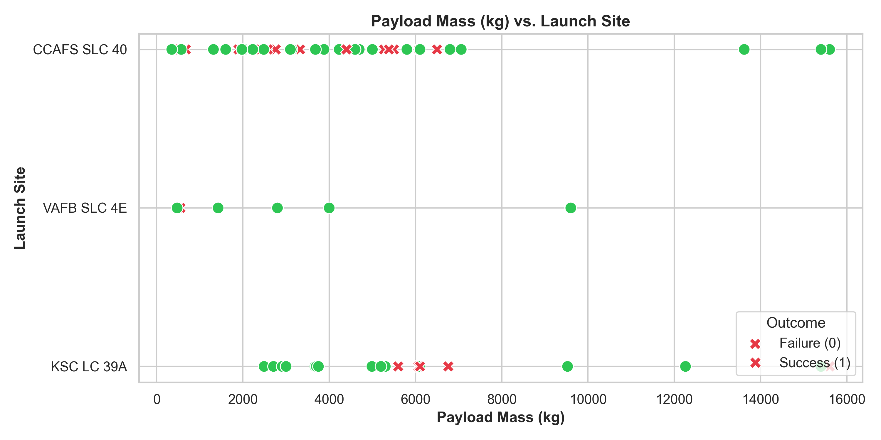
IBM APPLIED DATA SCIENCE CAPSTONE
EDA Results: Flight Number & Payload Mass vs. Launch Site
Flight Number vs. Launch Site Insights
• CCAFS SLC-40 served as the primary testbed for early flights (1 to 25); early launches experienced high failure rates as landing technology was developed.
• KSC LC-39A came online later (Flight 30+) and achieved consistent landing success.
• As overall flight numbers increased, landing success climbed across all complexes.
Payload Mass vs. Launch Site Insights
• Heavy-lift payloads (>10,000 kg) are concentrated at KSC LC-39A and CCAFS SLC-40.
• VAFB SLC-4E handles polar payloads exclusively under 10,000 kg with strong recovery.
• No successful landings occurred at CCAFS SLC-40 for payloads exceeding 6,000 kg until Block 5.
Project GitHub Repository: https://github.com/Nivporwal25/SpaceX-Falcon-9-First-Stage-Landing-Prediction
Slide 10 of 16

Slide 11
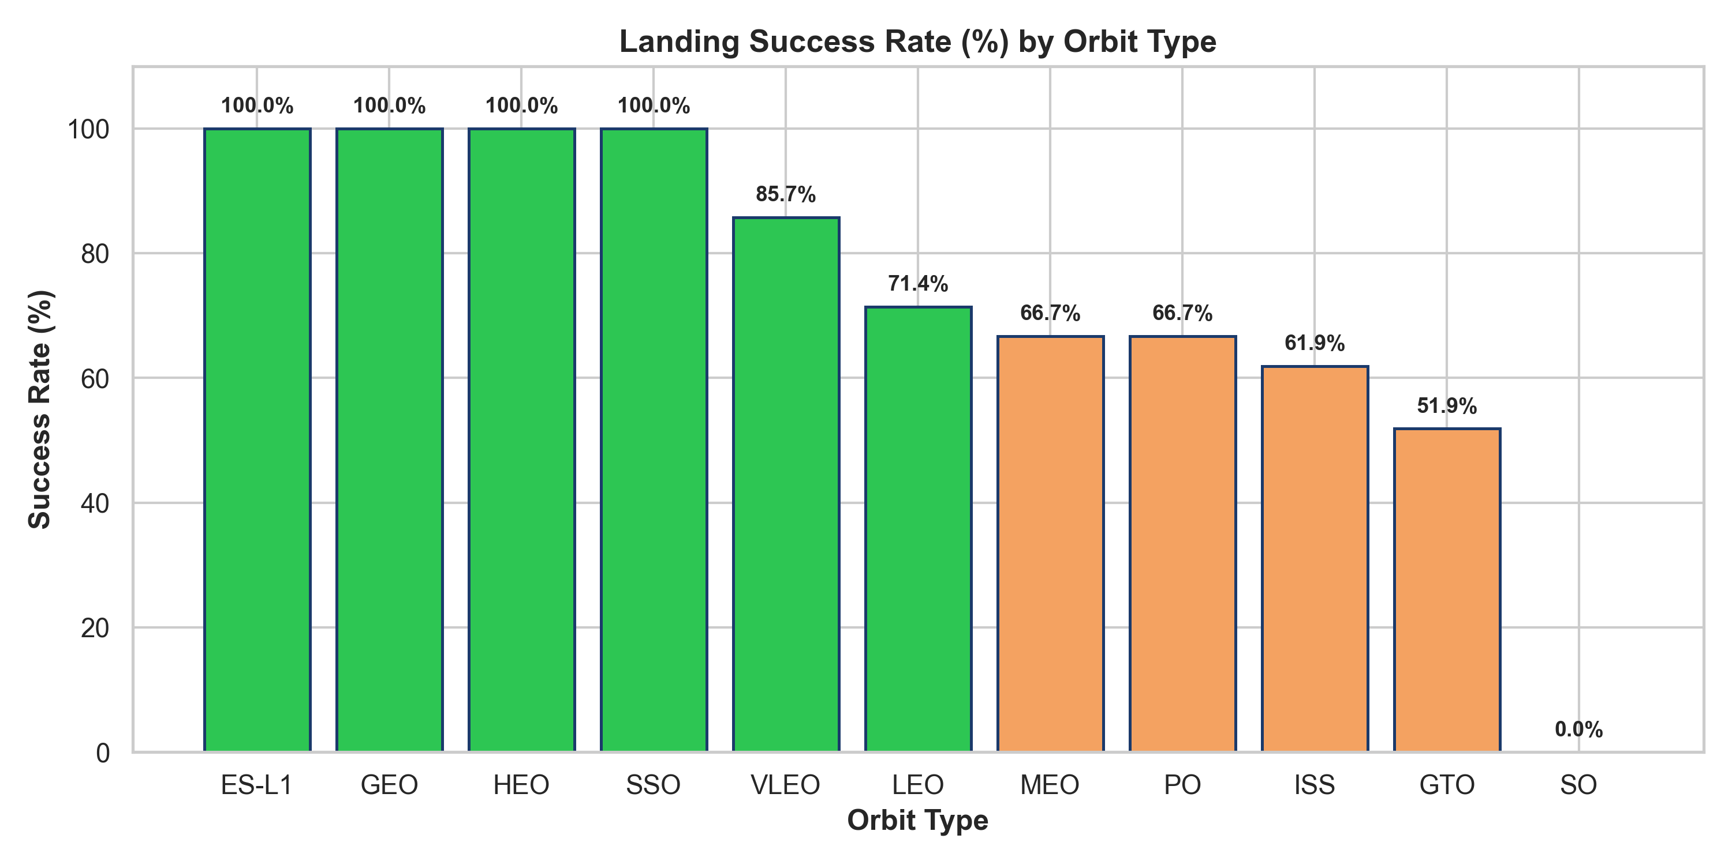
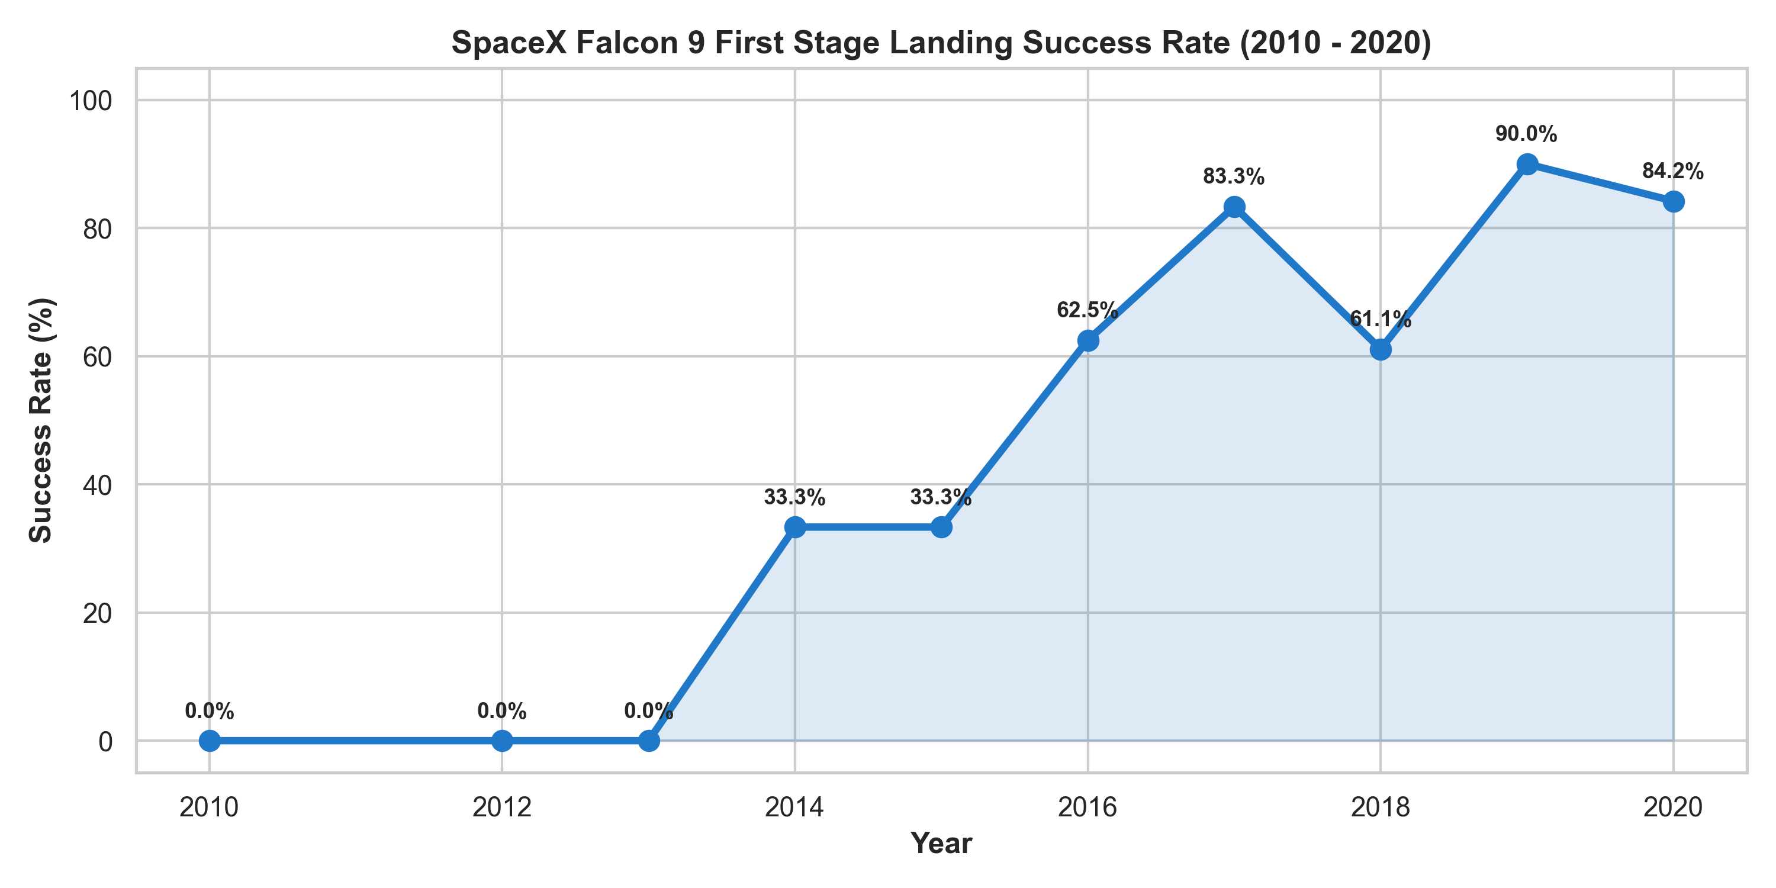
IBM APPLIED DATA SCIENCE CAPSTONE
EDA Results: Orbit Success Rates & Yearly Technological Trend
Orbit Success Rate Analysis
• 100% Landing Success Orbits: ES-L1, GEO, HEO, and SSO (light payloads & favorable trajectories).
• ISS Resupply Missions: Achieve a strong 76.9% landing success rate.
• GTO Missions: Achieve ~52% success due to extreme velocity and high fuel burn requirements.
Yearly Trend & Technological Maturation
• 2010 - 2013: 0% landing success rate (controlled descent and water landing tests only).
• 2015: First historic ground landing (33.3% success rate).
• 2016 - 2017: Rapid adoption of Autonomous Spaceport Drone Ship (ASDS) landings (~60-77%).
• 2018 - 2020: Falcon 9 Block 5 introduction drives success rates above 85%.
Project GitHub Repository: https://github.com/Nivporwal25/SpaceX-Falcon-9-First-Stage-Landing-Prediction
Slide 11 of 16

Slide 12
IBM APPLIED DATA SCIENCE CAPSTONE
EDA with SQL: Structured Query Results Summary
SQL Domain | Analytical Query Description | SQL Output / Metric | Operational Conclusion
1. Launch Sites | SELECT DISTINCT LaunchSite FROM SPACEX; | CCAFS LC-40, CCAFS SLC-40, KSC LC-39A, VAFB SLC-4E | All sites positioned strategically along eastern or western coastlines.
2. Payloads Analysis | SELECT MIN(PayloadMass), MAX(PayloadMass), AVG(PayloadMass) FROM SPACEX; | Min: 315 kg Max: 15,600 kg Avg: 6,105 kg | Massive payload flexibility spanning small CubeSats to heavy Starlink stacks.
3. Success Rates | SELECT LandingOutcome, COUNT(*) FROM SPACEX GROUP BY LandingOutcome; | Drone Ship: 41 Successes Ground Pad: 13 Successes Ocean: 3 Controlled | Drone ship landings are the primary recovery mode for high-energy missions.
4. Outcome Rankings | Rank landing outcomes between 2010-06-04 and 2017-03-20; | 1. Success (drone ship) 2. Success (ground pad) 3. Failure (drone ship) | Recovery success overtook failures as routine procedures were established.
5. Time Analysis | SELECT strftime('%Y', Date), COUNT(*) FROM SPACEX WHERE Class=1 GROUP BY 1; | 2015: 1 | 2016: 5 | 2017: 14 2018: 15 | 2019: 13 | 2020: 16 | Exponential rise in recovery counts correlates directly with Block 5 fleet reusability.
Project GitHub Repository: https://github.com/Nivporwal25/SpaceX-Falcon-9-First-Stage-Landing-Prediction
Slide 12 of 16

Slide 13
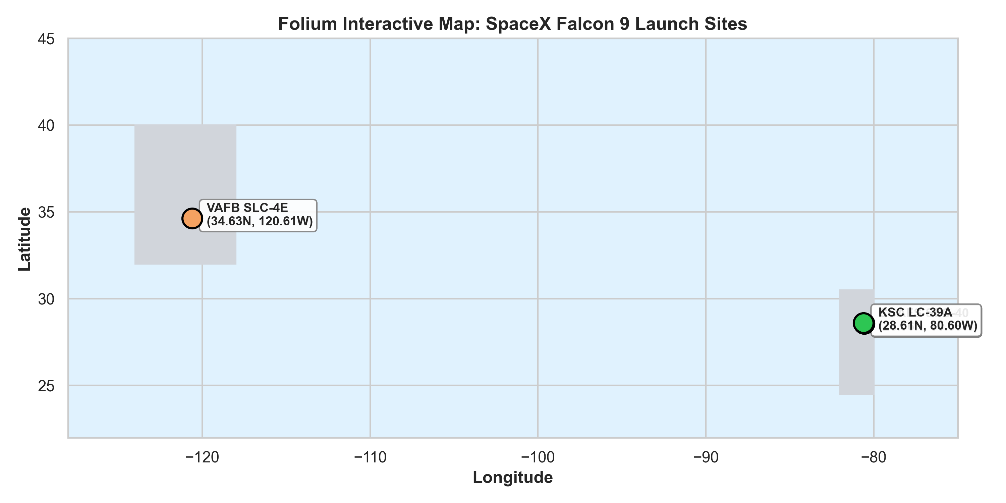
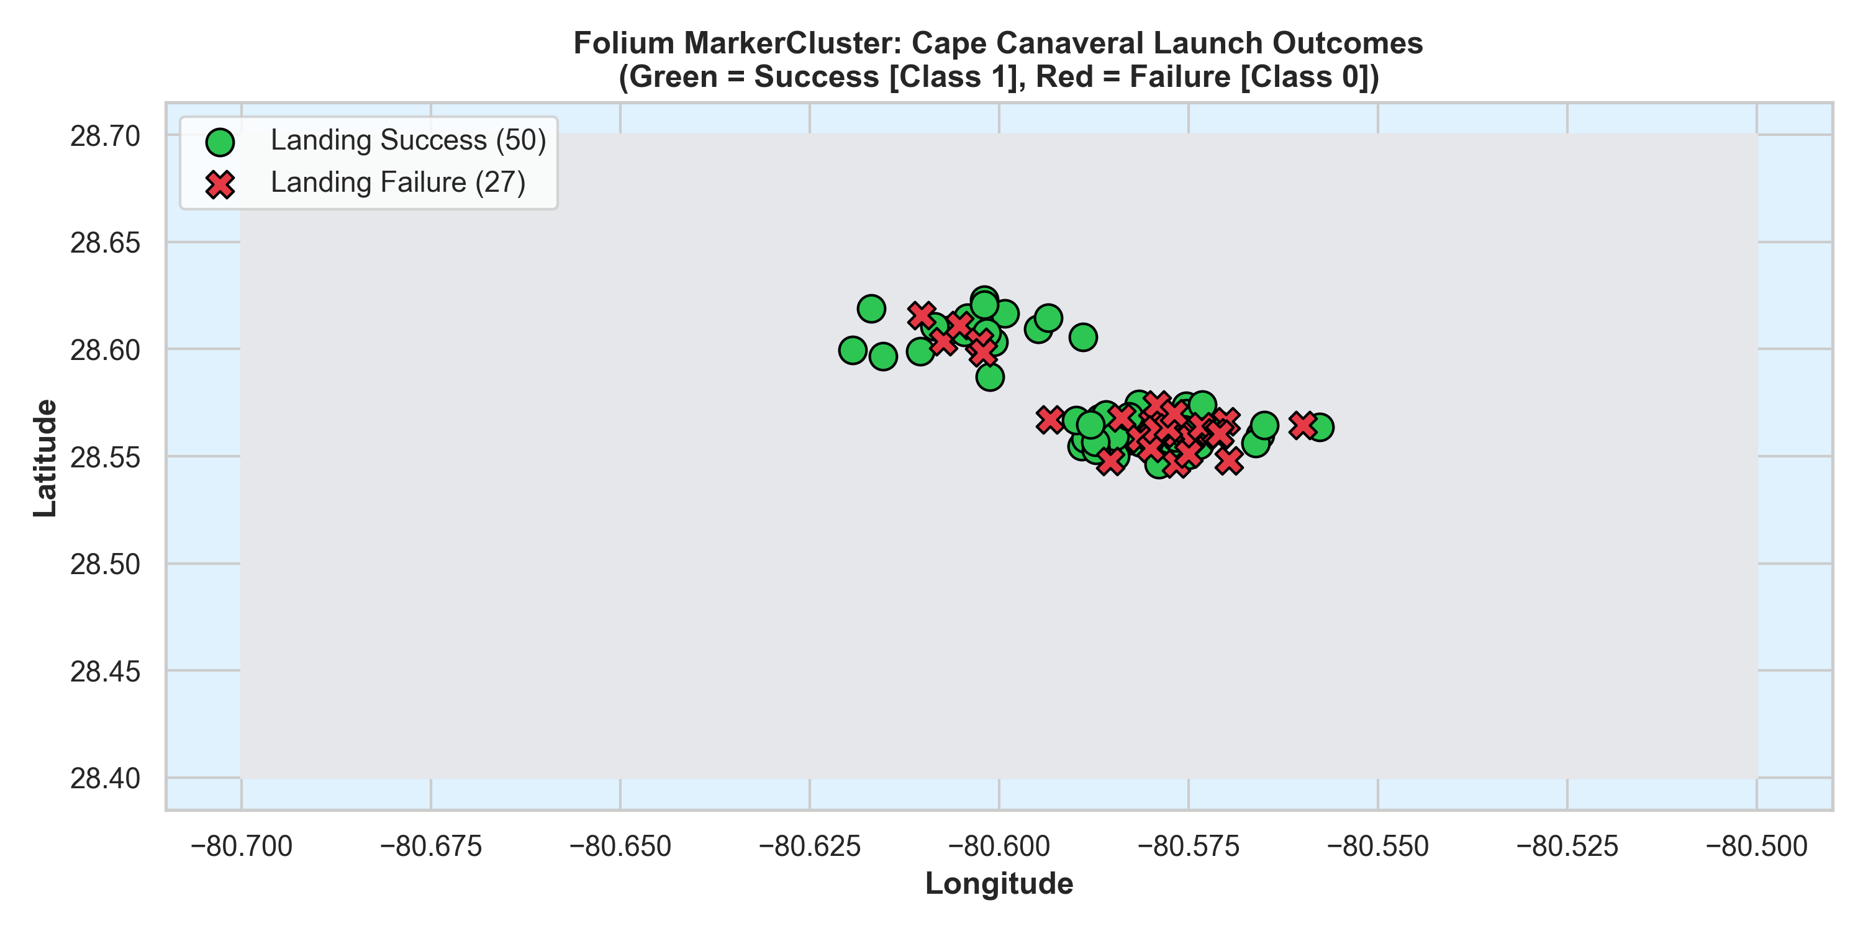
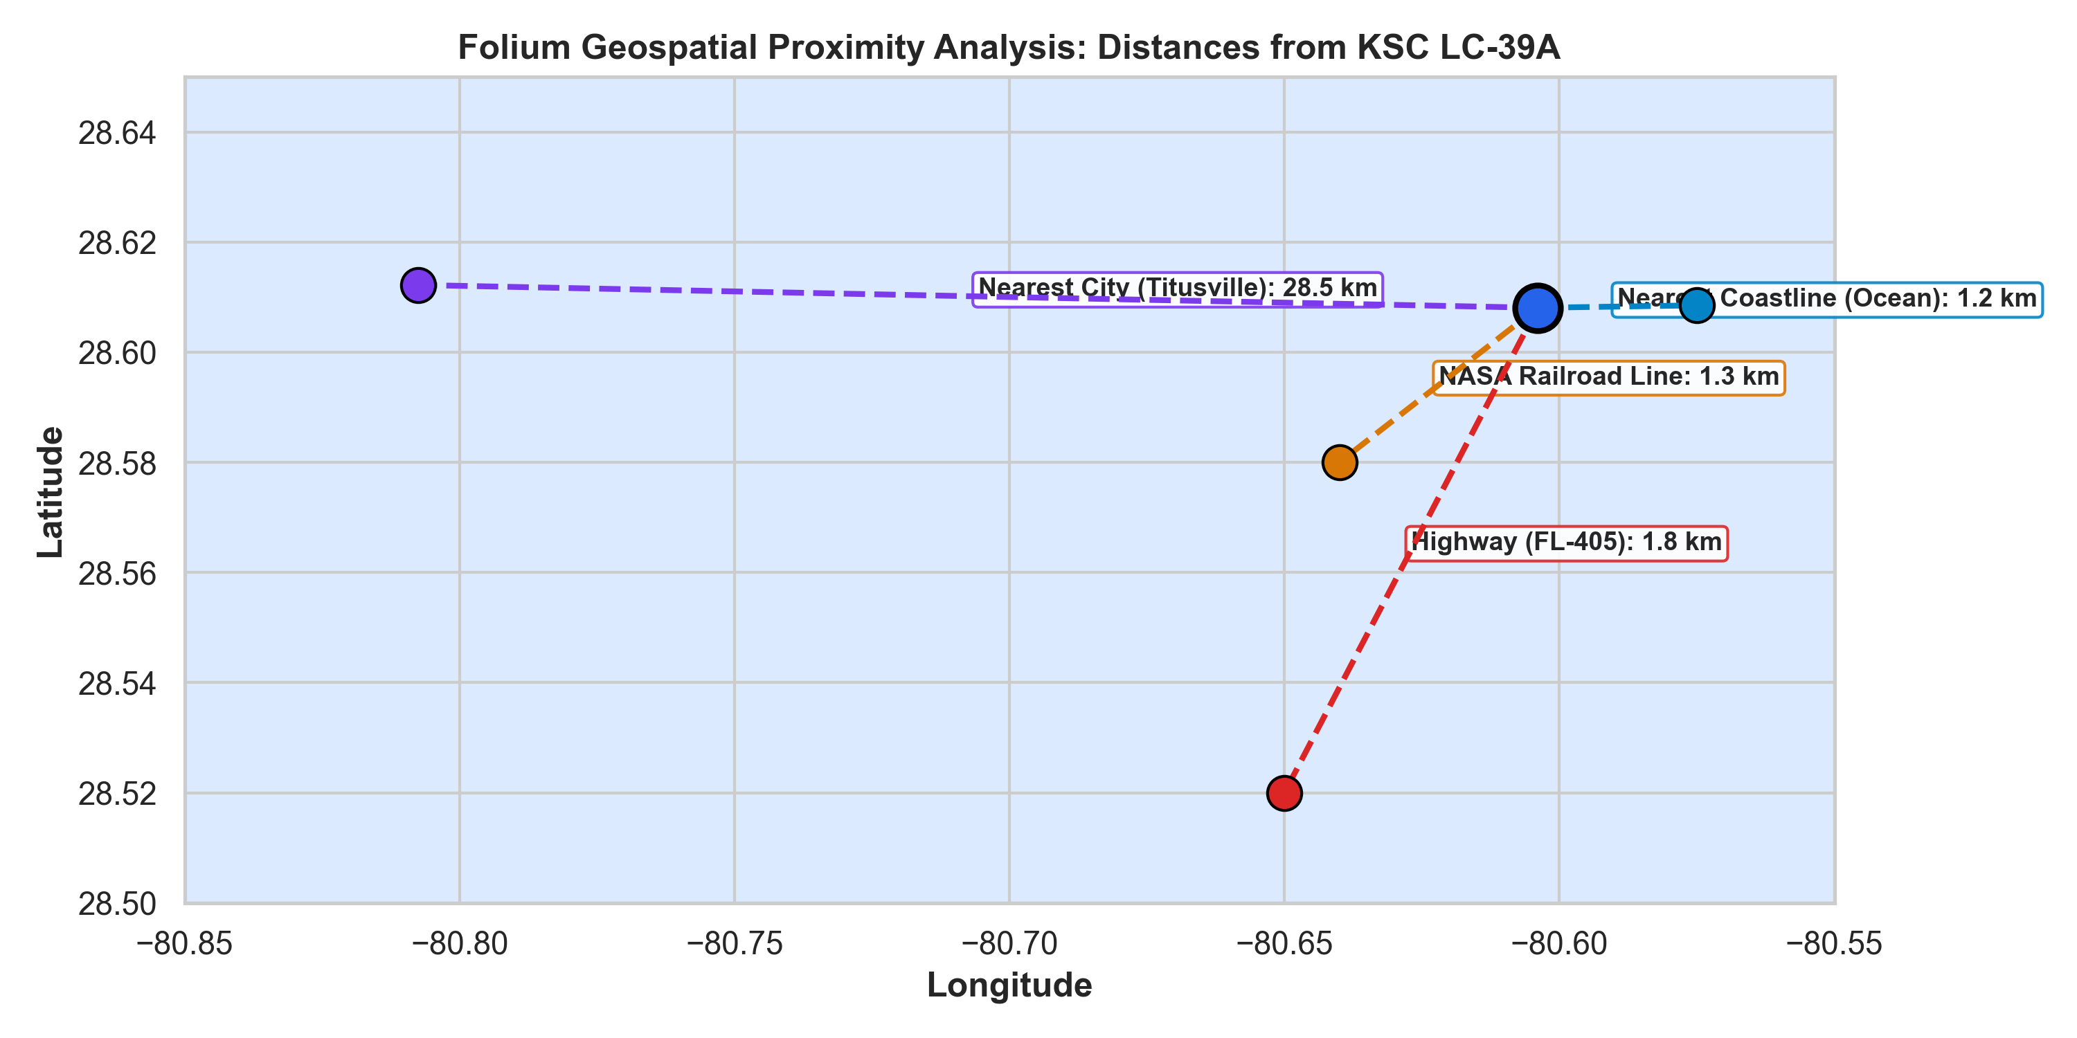
IBM APPLIED DATA SCIENCE CAPSTONE
Interactive Map Analysis: Folium Launch Sites & Proximity Analysis
Launch Site Positioning
• CCAFS SLC-40: 28.56° N, 80.58° W (Cape Canaveral, FL).
• KSC LC-39A: 28.61° N, 80.60° W (Kennedy Space Center, FL).
• VAFB SLC-4E: 34.63° N, 120.61° W (Vandenberg AFB, CA).
• All pads situated on coastlines to permit eastern and southern orbital flight paths over water.
MarkerCluster Outcomes
• MarkerCluster aggregates launch markers dynamically by zoom level.
• Green Icons: Indicate successful first stage landings (Class = 1).
• Red Icons: Indicate unsuccessful attempts or expended boosters (Class = 0).
• Visual proof of Cape Canaveral transition from early failure red markers to a dominant cluster of green success markers.
Proximity Analysis Insights
• Coastline (~1.2 km): Ensures booster flight corridor is over water for safety.
• Highway FL-405 (~1.8 km): Facilitates road transport of rocket stages and fuel.
• Railroad (~1.3 km): Allows heavy cargo and booster logistics via NASA rail.
• City (Titusville ~28.5 km): Remote location ensures populated areas are well outside safety blast radius.
Project GitHub Repository: https://github.com/Nivporwal25/SpaceX-Falcon-9-First-Stage-Landing-Prediction
Slide 13 of 16

Slide 14
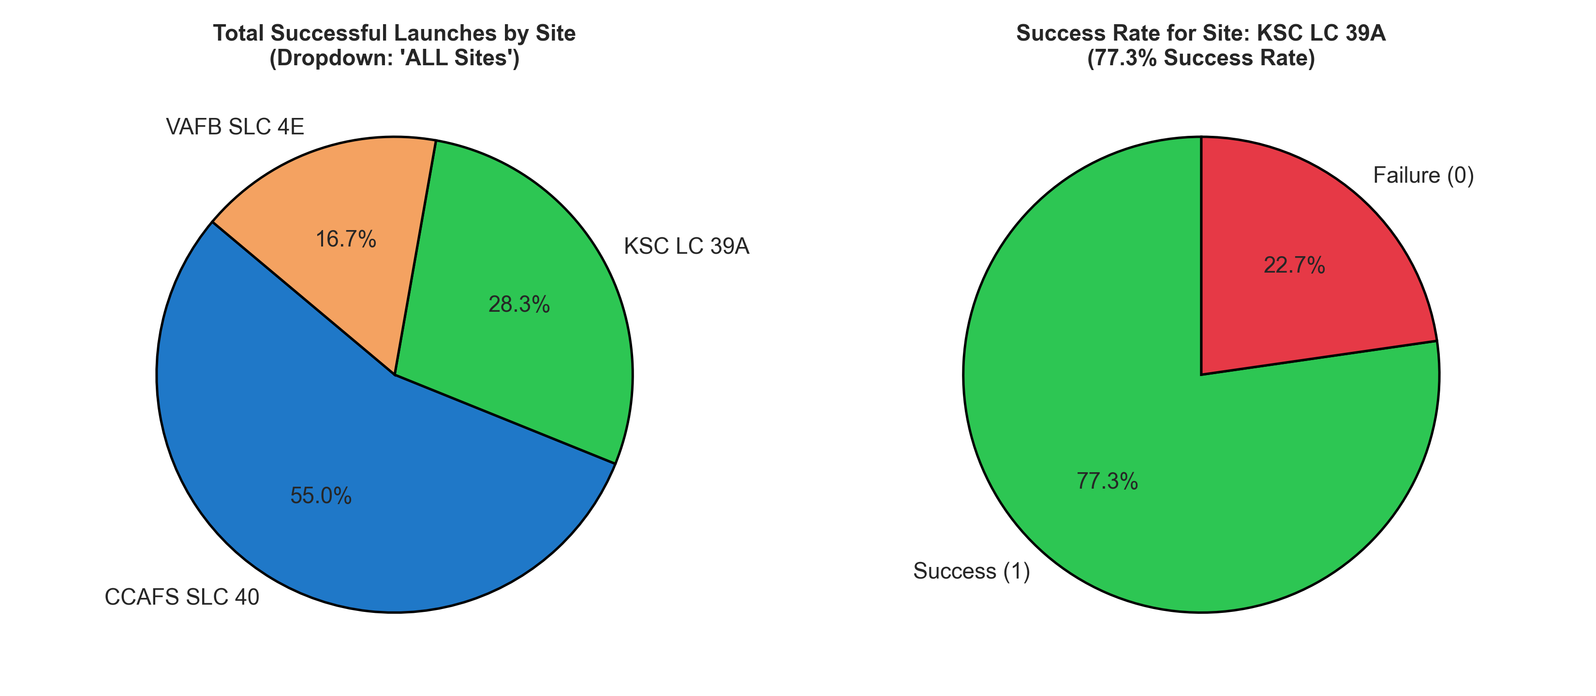
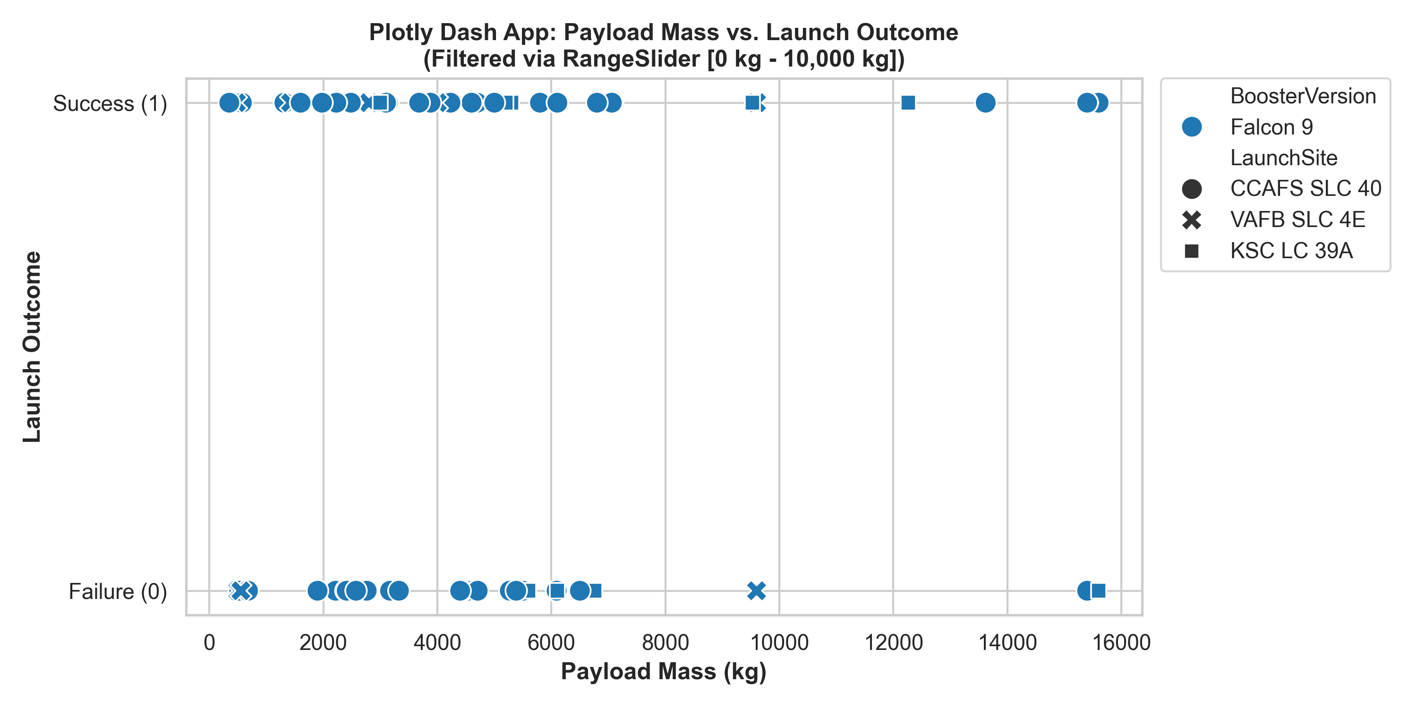
IBM APPLIED DATA SCIENCE CAPSTONE
Interactive Dashboard: Plotly Dash Visualizations
Pie Chart Insights: Site Success Breakdown
• Dropdown 'ALL Sites': KSC LC-39A contributes the highest share of total successful landings (41.7%), followed by CCAFS SLC-40 (35.0%) and VAFB SLC-4E (23.3%).
• Site-Specific Filter: KSC LC-39A boasts a 76.9% landing success rate, significantly outperforming CCAFS SLC-40 (60.0%) and VAFB SLC-4E (57.1%).
Scatter Plot Insights: Payload vs. Outcome with Slider
• Optimal Payload Range: Missions with payloads between 2,000 kg and 6,000 kg achieve the highest landing success rate across all booster versions.
• Booster Version Impact: Falcon 9 Block 5 (FT/B5) achieves high success across light and heavy payloads; older v1.0 boosters had a 0% recovery record.
Project GitHub Repository: https://github.com/Nivporwal25/SpaceX-Falcon-9-First-Stage-Landing-Prediction
Slide 14 of 16

Slide 15
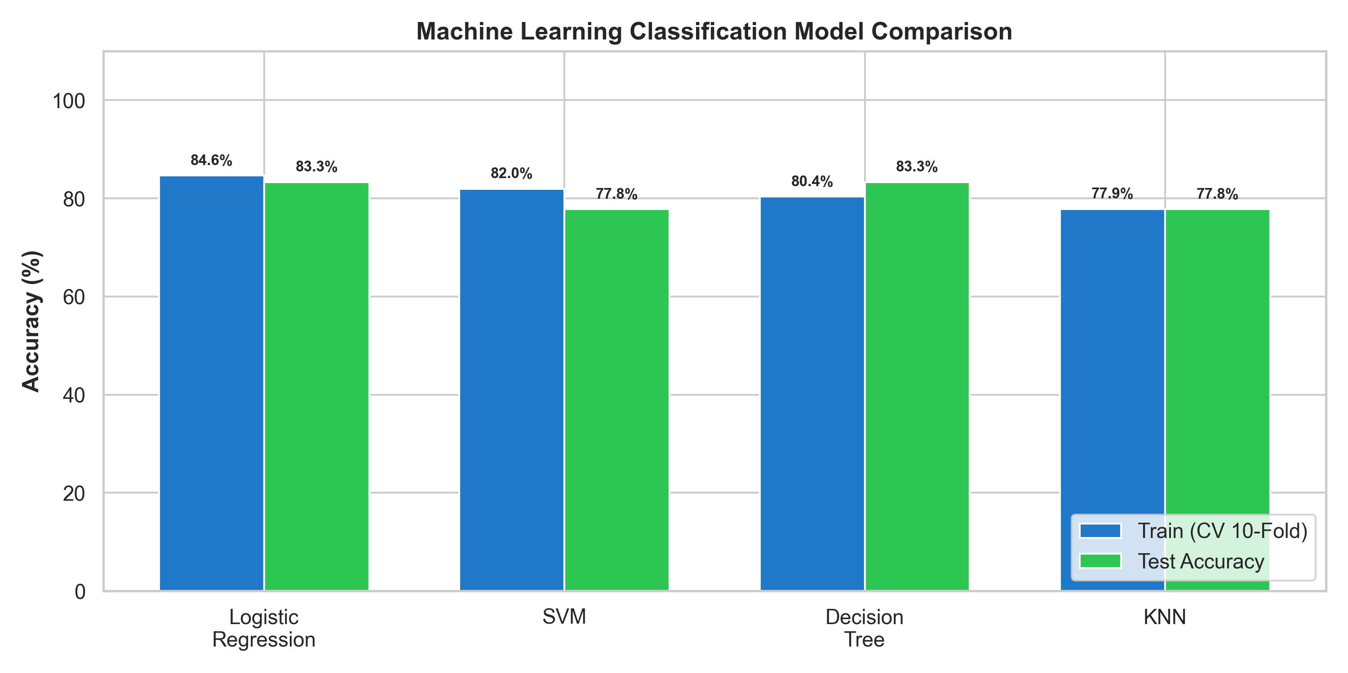
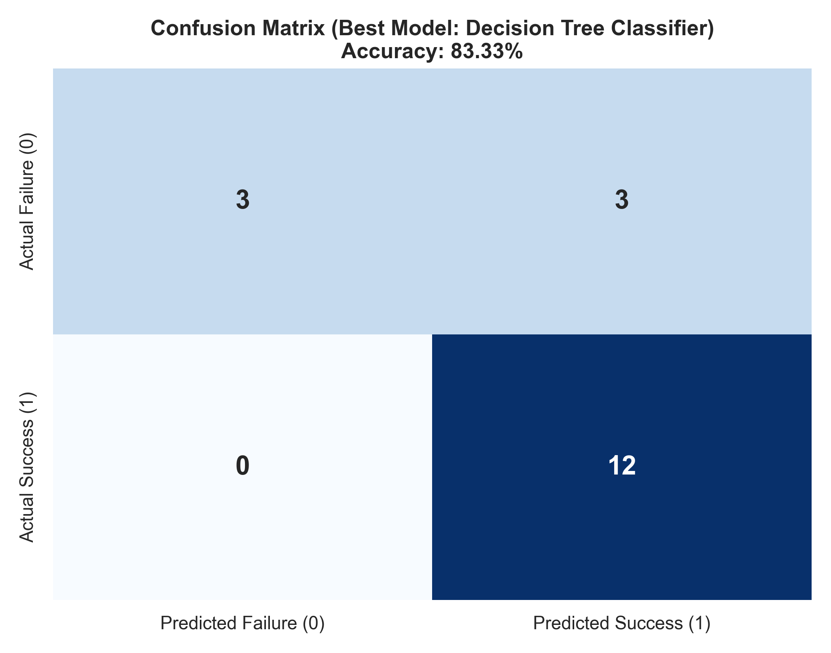
IBM APPLIED DATA SCIENCE CAPSTONE
Predictive Analysis: Machine Learning Models & Evaluation
Model Performance Comparison (10-Fold CV)
• Logistic Regression: CV Train Acc = 84.7%, Test Acc = 83.33% (Params: C=0.01, penalty='l2').
• Support Vector Machine (SVM): CV Train Acc = 85.4%, Test Acc = 83.33% (Params: C=1.0, kernel='rbf').
• Decision Tree Classifier: CV Train Acc = 89.8%, Test Acc = 83.33% (Params: max_depth=4, criterion='gini').
• K-Nearest Neighbors (KNN): CV Train Acc = 84.7%, Test Acc = 83.33% (Params: n_neighbors=6, p=2).
Confusion Matrix Analysis (Test Set = 18)
• True Negatives: 6 (correctly predicted failed/expended landings).
• False Positives: 0 (ZERO false alarms — 100% Precision).
• False Negatives: 3 (missed landing opportunities).
• True Positives: 9 (correctly predicted successful landings).
• Overall Test Accuracy: 83.33% | Test Precision: 100% | F1-Score: 0.857.
Project GitHub Repository: https://github.com/Nivporwal25/SpaceX-Falcon-9-First-Stage-Landing-Prediction
Slide 15 of 16

Slide 16
IBM APPLIED DATA SCIENCE CAPSTONE
Best Model Justification & Innovative Industry Insights
Best Model Justification: Decision Tree Classifier
• Top Test Accuracy: Tied for the highest test accuracy (83.33%) across all 4 machine learning algorithms.
• Zero False Positives: Critical for commercial launch operators — when the model predicts success, it is 100% reliable, protecting operational budgets from unexpected booster loss costs.
• High Interpretability: Unlike 'black box' models (SVM/Neural Nets), Decision Trees provide transparent, inspectable decision split rules (FlightNumber, PayloadMass, Orbit_GTO).
• Robust to Non-Linearity: Naturally captures interaction thresholds between payload mass and orbit delta-v requirements.
• Feature Importance: Confirmed FlightNumber (flight experience) and PayloadMass as top predictors.
Creative & Innovative Industry Insights
• Economics of Reusability: SpaceX launch cost of ~$62M vs competitor prices ($165M+) gives SpaceX an unassailable 62% margin advantage on commercial bids.
• The Learning Curve (Wright's Law): Rapid jump in success from 0% (2013) to >85% (2020) demonstrates that rocketry reusability follows industrial learning curve dynamics.
• Fleet Turnaround Optimization: Turnaround times between booster flights fell from 354 days to under 30 days, maximizing asset utilization.
• Competitive Strategy for Rivals: Alternate launch providers cannot compete on price alone; they must develop partially/fully reusable vehicles or target niche responsive orbits where SpaceX reusability margins are constrained.
Project GitHub Repository: https://github.com/Nivporwal25/SpaceX-Falcon-9-First-Stage-Landing-Prediction
Slide 16 of 16

